Slide 1
MIPs Influence Cascade Ecosystem (ICE): Entropy-based
Ozlem Garibay (PI), William Rand (Co-PI), Ivan Garibay (Co-PI), Alexander Mantzaris (Co-PI), Una-May O'Reilly (Co-PI)
University of Central Florida, North Carolina State University, Massachusetts Institute of Technology
ozlem@ucf.edu
DARPA Modeling Influence Pathways (MIPs) AIE
1:1 Status Meeting
06 December 2023
(Date of last 1:1 status meeting: 10/05/2023)

Slide 2
Bottom Line Up Front (details in subsequent slides)
Phase I Results Influence Cascade Ecosystem: Entropy-based
Recap of Phase I Results: Application of Transfer Entropy on Social Media Data/Pathway Detection
Phase II Current Results Influence pathway research
Scenario: Ukraine War, Data: +12 million tweets
Expand analysis: to better understand influence pathways, guided by our disinformation defense research framework
Generalizability, +10 scenarios, +assassinations data
All the scenarios data collection is done
Analyzing the influence pathways in different datasets (RC1)
LLM as Climate Change Information Content Generator (RC2)
Credibility Crossover, Audience Crossover, Echo Chambers in relation with audience volume
Investigation of Transfer Entropy with Multiplex Networks (RC1)
Identifying the most influential platform/individuals for information transmission(RC3)
Quantifying the information transfer across platforms/individuals (RC3)
Detecting the change point and predict the information cycle (RC3)
Synthetic data (+100,000 scenarios), identification and prediction of pathways using data augmentation
Verifying the Robustness of Transfer Entropy Networks (RC4)
Addressing the Crutchfield paper (RC4)
Phase III Objectives
Coordination campaigns
Early detection of emerging campaigns
Issues from the past reporting period - None

Slide 3
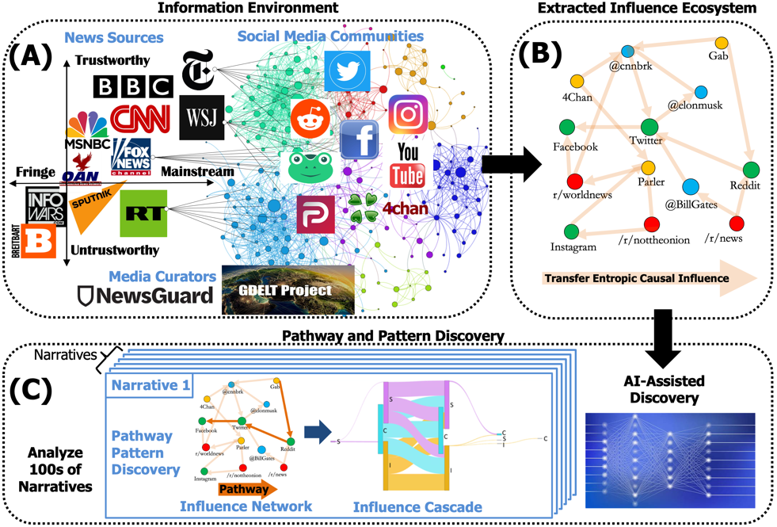
Approach
Goal: Identify, model and characterize the pathways used to propagate and amplify disinformation and manipulated information in the influence ecosystem using a transfer-entropy derived influence network.
Approach
Focus on information environment cross section relevant to information warfare: Platforms/ communities (pathway nodes) that share and discuss geopolitical news articles.
Extract meaningful and feature rich network of influences (pathway links) from the information environment using activity time series and transfer entropy per analyzed narrative. Capture heterogenous influence via news source trustworthiness and popularity.
Leverage influence cascade methodology and multi-headed self-attention DNNs to perform pattern and pathway discovery and modeling
High-level tasks and status
Acquire and transform data to integrate news sources, social media messages and event data.
Extract influence ecosystem
Discover pathways and patterns
The information contained in this document is not for public release. It is the Property of the University of Central Florida
3

Slide 4

Decomposition of top-down questions for influence pathways
Role | Task | Forensic: What happened? | Reactive: What is going on? | Proactive: What will happen?
Information Analyst | Identify paths to audience | What were the paths to the audience? ICE: Find set of paths to audience RC4
 | Create map of influence pathways | What do pathways look like? ICE: Display all paths RC4
 | Attribute influence | Who was the information source and the actors? ICE: Extract attributes of actors and sources in cascade RC4
 | Influence impact assessment | Who was the audience, and have they been influenced? ICE: Cluster audience and their belief change RC4 | Who is the audience and are they influenced? ICE: Cluster audience and their belief change RC1 | Who is the audience, and will they be influenced? ICE: Cluster potential audience and their projected belief change RC2
Content Moderator | Limit audience |  | Which actors should be limited? ICE: Cluster cascades to find nodes
 | Limit arrival (timing) |  | When and what degree of limits on actors? ICE: Cluster cascades and find nodes that frequently influences
Information Operator | Detect influence |  | Who are the actors and audience? ICE: Match with known paths RC1, RC3
 | Prevent influence |  |  | Who could be an actor and audience? ICE: Match with known and variants of paths
 | Craft message |  | What will influence the audience? ICE: Match source information with audience RC2 | What could influence the audience? ICE: Match source information with possible audience RC2
Revisited with Ukraine Data
Questions (Phase II)

Slide 5
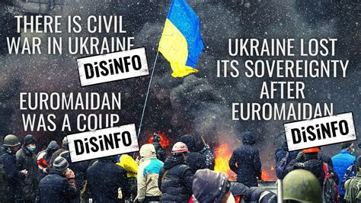
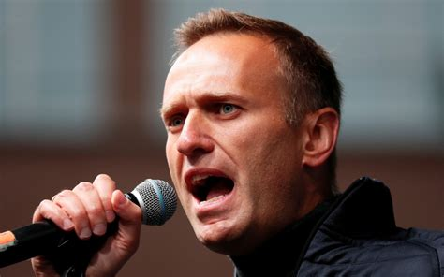

1. Generalizability Questions: Compare and Contrasts
10+ New Disinformation Scenarios
Analysis of new Ukraine War scenarios impact in UK
Are there hidden influencers (George Galloway) also in the Ukraine War disinformation?
Are the influence pathways similar?
Are the top influencers similar?
Assassination/Assassination Attempts Scenarios
Alexei Navalny, Jamal Khashoggi, Kobe Bryant (control)
How do other assassinations pathways compare?
How Skripal case compare to a non-assassination data (Kobe)
Do the networks/pathways look similar for the Skripal case?
Climate Change Scenarios

Slide 6
RC1

Slide 7
RC1

Slide 8
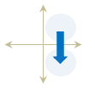
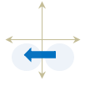
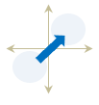
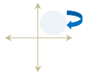
2. Influence Relationships: Crossovers and Eco Chambers, Audience
Trustworthy
TF
TM
Credibility Crossover, Audience Crossover, Double Crossover, Echo Chambers in relation with audience volume
Do credibility and audience crossovers have common characteristics across scenarios for disinformation? Are those different from non-disinformation scenarios?
How about influence echo chambers?
Would the top influencers and controversial authors defined in the Skripal incident re-emerge again in the Ukraine war influence operations? Would we find the same influence dynamics we discovered during the Skripal case?
Will Craig Murray be the personnel who is critical to the success of the Russian media influence operation for the Ukraine war narrative as he was for the Skripal? Or who else? How would they compare?
Under what conditions and when do crossover/echo chambers occur? Relationship with void?
Fringe
Mainstream
News source credibility
UF
UM
Online discussion audience
Untrustworthy
News source audience

Slide 9
RC1

Slide 10
RC1

Slide 11
RC2

Slide 12
RC2

Slide 13
RC2

Slide 14
RC3

Slide 15
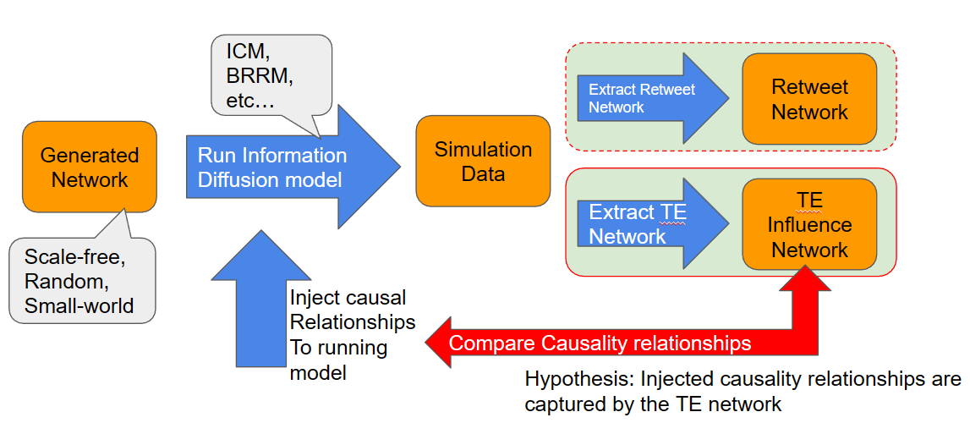
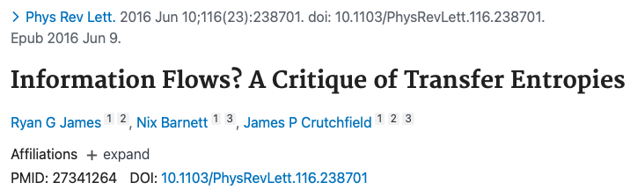
3. Synthetic Data Generator, Pathway Identification and Prediction, ML
Data Augmentation: Synthetic Data Generation, +100,000 scenarios
Data: Skripal case (1), Ukraine War (10), not enough for ML
Data Sub-types: 11 scenarios x (60 time-windows) x (2 stances) x (16 types) = 21,120 unique influence networks/pathways
Pathway Identification and Prediction ML Models
TE Limits?: Look at how transfer entropy can uncover networks of influence. There are a few papers which explored isolated aspects of the usage of transfer entropy which has cast a shadow upon the general usage of transfer entropy, and we will explore empirically through ground truth simulations the validity of such potential pitfalls and highlight the positive merits.
Validating TE identification of causal relationships

Slide 16
RC4

Slide 17
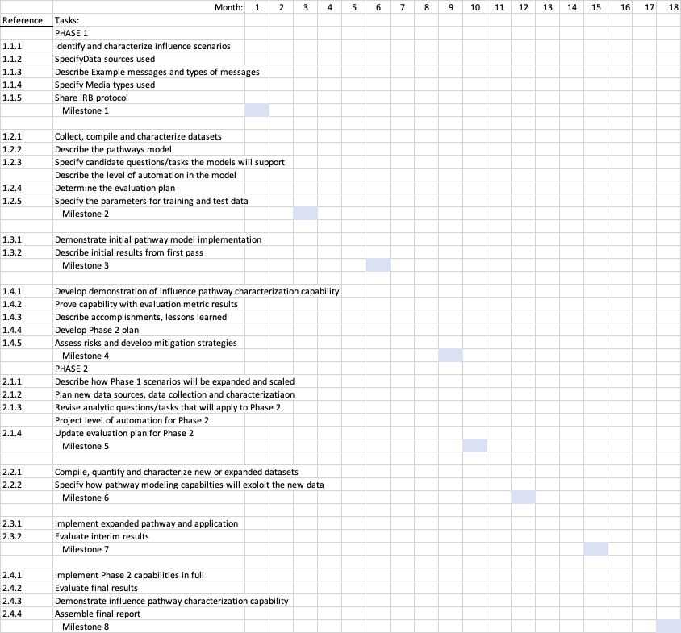
Schedule
Milestone 8:
2.4.1 Implement Phase 2 capabilities in full
2.4.2 Evaluate final results
2.4.3 Demonstrate influence pathway characterization capability
2.4.4 Assemble final report
We are here

Slide 18
Products and Publications
Date | Citation | Topic | Link to Paper
2022 | Ozlem Garibay, Niloofar Yousefi, Kevin Aslett, Jacopo Baggio, Erik Hemberg, Chathura Jayalath, Alexander Mantzaris, Bruce Miller, Una-May O'Reilly, William Rand, Chathurani Senevirathna and Ivan Garibay (2022). Entropy-Based Characterization of Influence Pathways in Traditional and Social Media. The 8th IEEE International Conference on Collaboration and Internet Computing | Entropy-based characterization of influence pathways | https://ieeexplore.ieee.org/abstract/document/10061757
2022 | Domenikos, G. R., & Mantzaris, A. V. (2022). A model simulation of political segmentation through an estimation of the entropy. Journal of Statistical Mechanics: Theory and Experiment, 2022(9), 093401. | Entropy-based simulation of political segmentation | https://iopscience.iop.org/article/10.1088/1742-5468/ac8800
2023 | Alexander V. Mantzaris, George-Rafael Domenikos "Exploring the entropic nature of political polarization through its formulation as an isolated thermodynamic system", Scientific Reports, (13) 4419, DOI: https://doi.org/10.1038/s41598-023-31585-w (2023) | Political polarization and transfer entropy | https://rdcu.be/c7QE9
2023 | Nikhil Ankolkar, David Roycroft, Xiaoxia Champon, William Rand, Chathura Jayalath, Ivan Garibay, Ozlem Garibay (2023). Everything is not as it seems: A study into the influence and dissemination of disinformation across social media | Influence and the dissemination of disinformation in social media | To be submitted to Journal of Information Systems
2023 | Xiaoxia Champon ,Chathura Jayalath ,Wiliam Rand ,Jasser Jasser ,Ivan Garibay (2023). Comparing Social Media Communities using Functional Data Analysis. HICSS conference 2024 | Comparing social media communities | Accepted – Final revision submitted
2023 | Domenikos, G. R., Laurie, T., Awaji, S., & Mantzaris, A. V. (2023). Defining the Entropy and Internal Energy of a Monetary Schelling model through the Energy States of Individual Agents. arXiv preprint arXiv:2309.06624. | Modeling sociological system using Monetary Schelling Model | https://arxiv.org/abs/2309.06624

Slide 19
Products and Publications
Date | Citation | Topic | Link to Paper
2023 | Chathura Jayalath, Chathika Gunaratne, William Rand, Chathurani Senevirathna, and Ivan Garibay. “A Generalization of Threshold-based and Probability-based Models of Information Diffusion”. In: Advances in Complex Systems 26.2 (in-press 2023), p. 2350005. doi : 10.1142/S0219525923500054. | Generalization of information diffusion models | https://www.worldscientific.com/doi/abs/10.1142/S0219525923500054
2023 | Ali Khodabandeh Yalabadi, Mehdi Yazdani-Jahromi, Sina Abdidizaji, Ivan Garibay, Ozlem Garibay (2023), Controlling the misinformation diffusion in social media by the effect of different classes of agents, Computational Social Science conference 2023, Santa-Fe NM, USA | Misinformation diffusion in social media | Accepted – CSS 2023
2023 | Chathura Jayalath, Xiaoxia Champon, Chathurani Senevirathna, Wiliam Rand, and Ivan Garibay (2023). Quantifying the Effect of Clustering Coefficient on Models of Information Diffusion. Computational Social Science conference 2023, Santa-Fe NM, USA | Effect of Clustering Coefficient on information diffusion models | Accepted – CSS 2023

Slide 20
Events
Date | Description | Venue / Participants
November 30, 2022 | Team workshop for MIPs Influence Cascade Ecosystem: Entropy-based | Orlando, Project team
November 2022 | Submitted paper: Russian disinformation campaigns | Web Conference/ Jasser Jasser
December 1, 2022 | Panel on Information Warfare for The Interservice/Industry Training, Simulation and Education Conference (I/ITSEC) | Orlando Convention Center/ Ozlem Garibay, Una-May O’Reilly, Ivan Garibay, William Rand, Alex Mantzaris
December 14, 2022 | Panel Discussion: Entropy-Based Characterization of Influence Pathways in Traditional and Social Media | The 8th IEEE International Conference on Collaboration and Internet Computing
March, 2023 | Two abstracts accepted at the Statistical Challenges in Electronic Commerce Research (SCECR) meeting based on MIPS work. The conference will be held on June 8 – 10, 2023, in Bogota, Colombia. | SCECR Meeting
April 24 - 27, 2023 | Thomas Galligani presented “Remote Sensing and Inference in the Information Environment” to the DAF Data, Analytics, and AI Forum, on April 24 – 27, 2023 in Washington, D.C. The intent of the conference was to share tools and techniques to leverage data for operational practitioners across the Air Force. | Erik Hemberg, Una-May O’Reilly, Thomas Galligani
June 8 – 10, 2023 | Statistical Challenges in Electronic Commerce Research (SCECR) meeting. Bogota, Colombia | Bill Rand, NCSU Team

